Slide 1
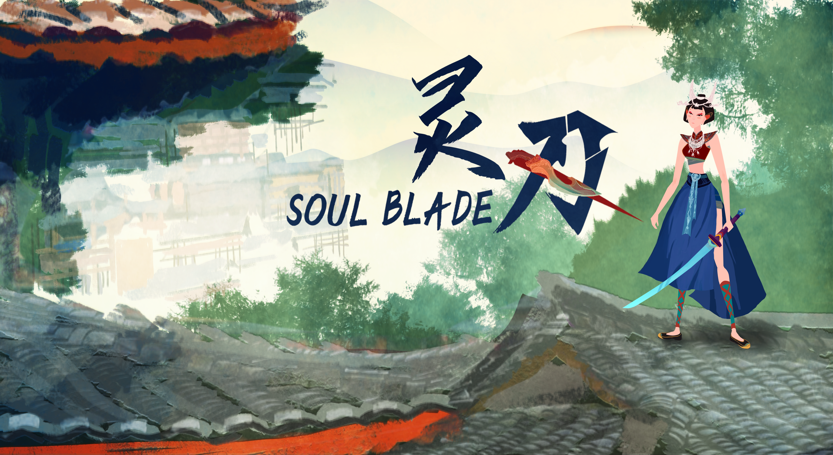
Elder Iron
Version 1.0.8

Slide 2
Summary
This week we started working on BOSS fight:
BOSS character design and rigging
BOSS skill design, provided 1st version of BOSS design documents
Changed the 2nd version of main character and animation. We also changed the size of main character for better experience.
Added camera control, camera will zoom automatically while player changed from battle to platform of inverse.
Changed the difficulty of level to make it more playable.
Added controlled supported, we also changed the keyboard setting to improve combat feeling.

Slide 3
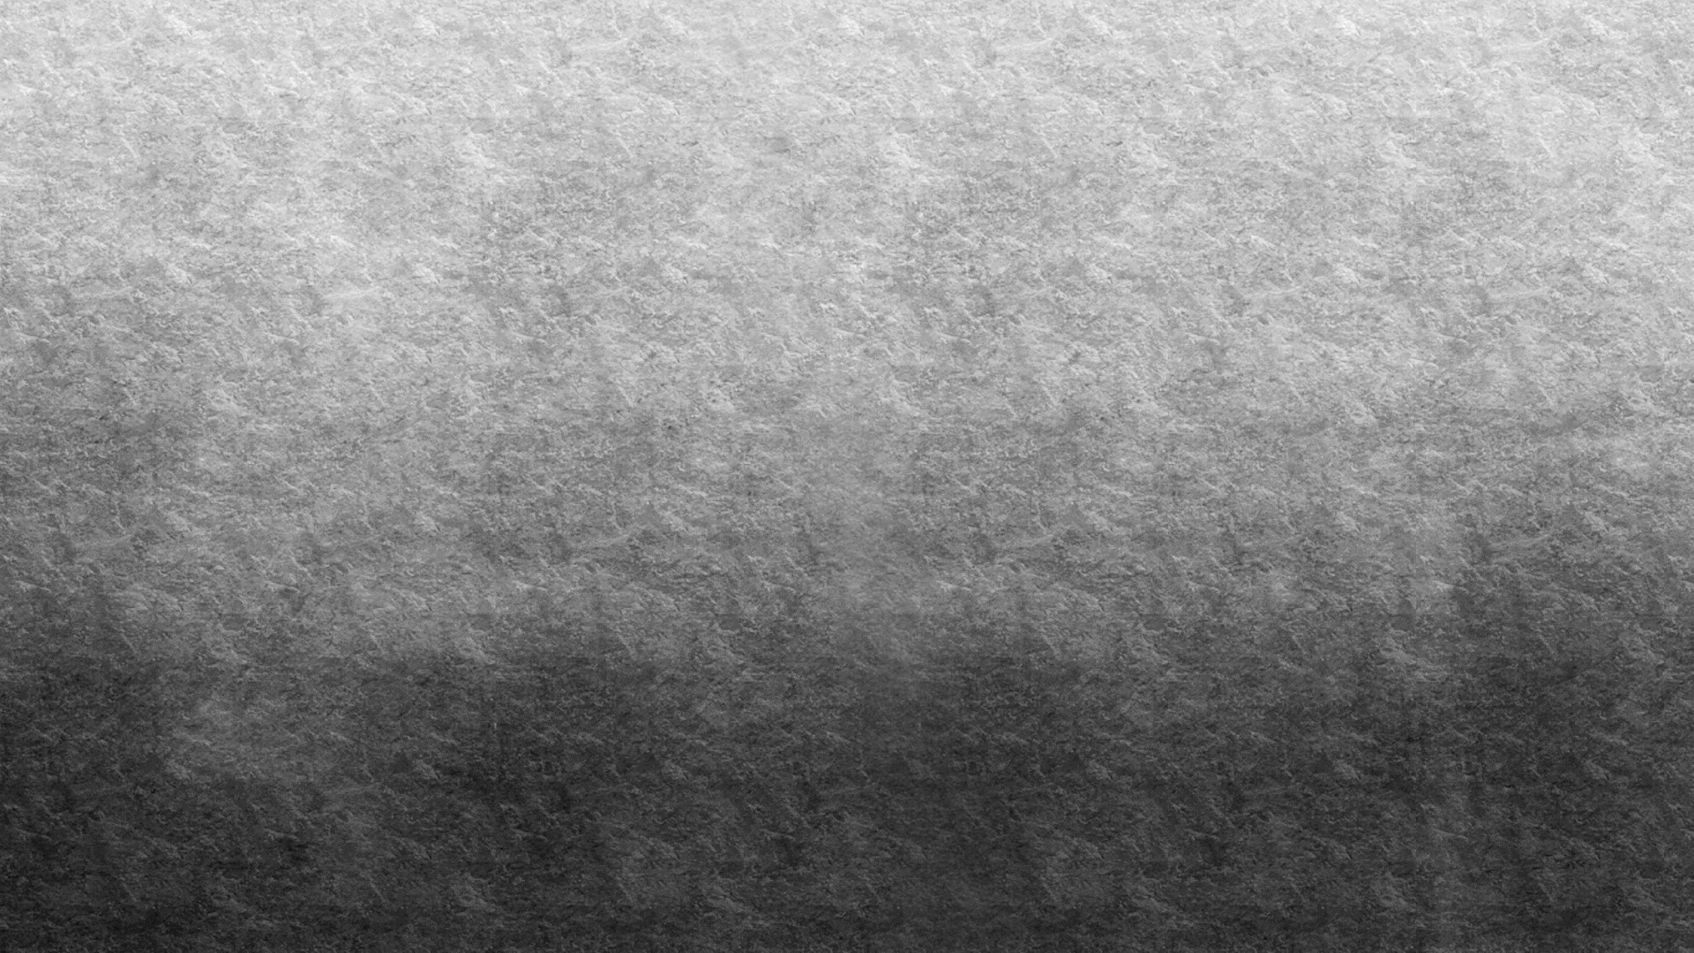
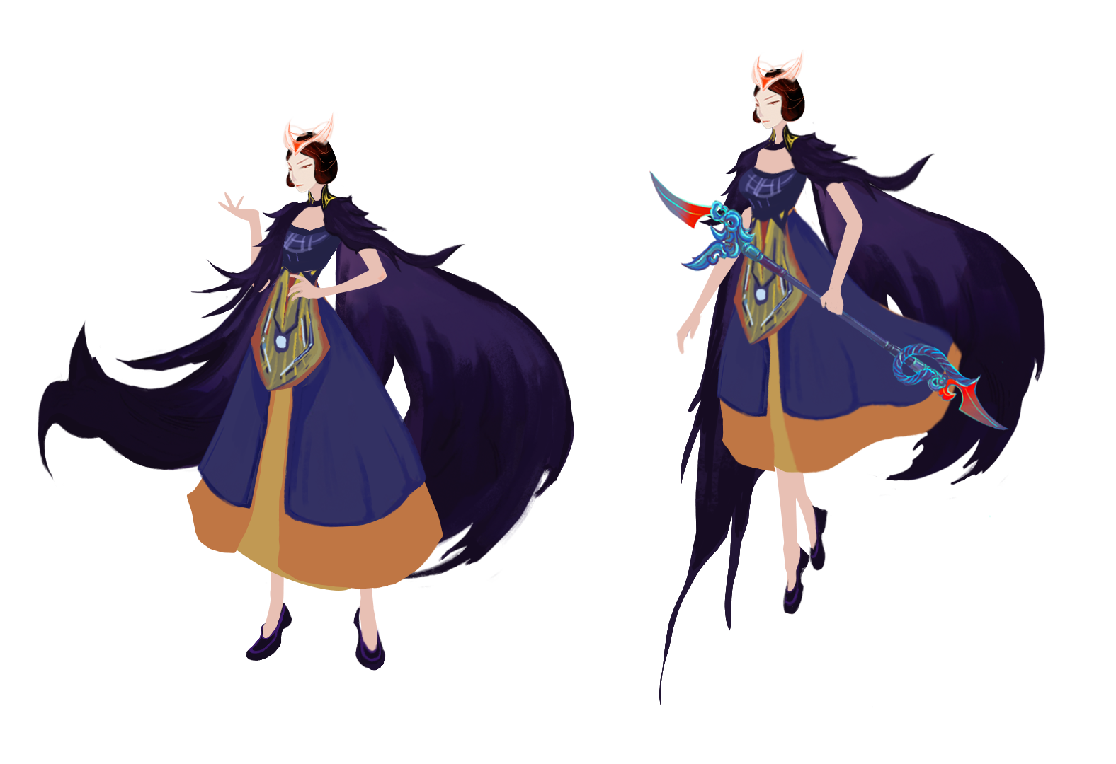
BOSS Design
Design details:
The back wings refer to the “Kao flag" in Chinese traditional opera, symbolizing the uniqueness of ancient Chinese generals. The design of the headdress adds bright red elements on the basis of the traditional silver horn ornaments, echoing with the design of the weapons. Purple is chosen as the main colour to show the mysterious character temperament.
On the ground
Levitating

Slide 4
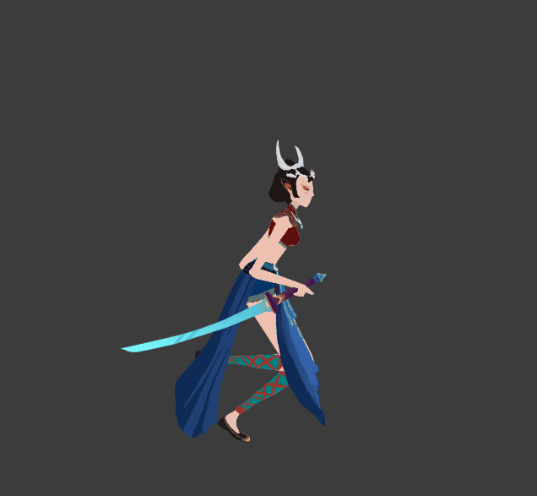
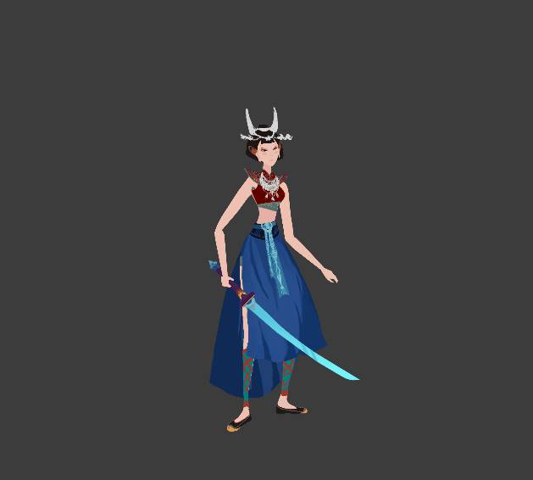
Character Action – the 2nd version
Run
Idle

Slide 5
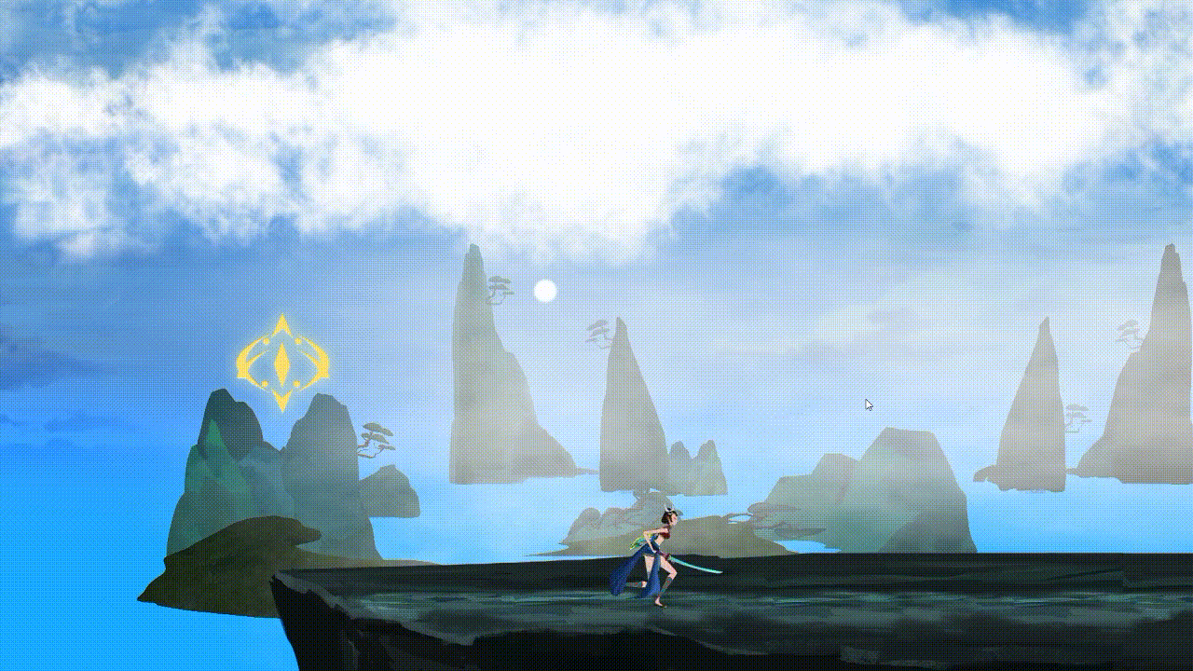
Camera Zoom

Slide 6
Plan for next step
Next week we will keep developing BOSS fight:
BOSS AI Design
BOSS Skill animation, SFX and VFX
BOSS fight scene
Function needed in Alpha version:
Refine of Character/Enemy attack animation
Scene assets added and refine.

Slide 7
Thanks！

